Slide 1


Green Pace
Security Policy Presentation
Developer: Caleb Ewer
Notes:
Slide 1: Introduction "Hello, my name is Caleb Ewer, and today I will be presenting the Green Pace Security Policy. This policy is designed to ensure secure coding practices and prevent vulnerabilities within our software development lifecycle. Throughout this presentation, I will cover key security principles, standards, automation strategies, and recommendations to maintain a strong security posture."

Slide 2

OVERVIEW: DEFENSE IN DEPTH
Green Pace’s security policy is designed to formalize the best practices we already follow and strengthen our defense-in-depth approach. It serves as a guide to prevent security vulnerabilities and promote consistency in coding and architectural decisions.
Notes:
Slide 2: Overview of Defense in Depth "Green Pace follows a defense-in-depth approach, layering multiple security measures to protect our applications and data. This policy formalizes best practices and enforces consistency in coding and architecture. By integrating security at every stage, we proactively mitigate threats before they can be exploited."

Slide 3
THREATS MATRIX
Unlikely: Low likelihood of being exploited but can be problematic in specific scenarios.
Low Priority: Less likely and have minimal impact but should still be addressed for compliance.
Likely: Common and pose significant risks: Require focused attention and proactive measures.
Priority: High remediation benefits and critical nature.
Likely STD-004-CLG STD-005-CPP | Priority STD-004-CLG STD-005-CPP
Low priority STD-001-CPP STD-006-CLG | Unlikely STD-003-CPP STD-006-CLG STD-010-CPP
Notes:
Slide 3: Threats Matrix "The Threats Matrix categorizes vulnerabilities based on their likelihood and impact. High-priority risks, such as SQL injection and memory protection, demand immediate action, while lower-priority issues still require attention for compliance and long-term security. Automation tools like SonarQube help detect and mitigate these threats efficiently."

Slide 4
10 PRINCIPLES
1. Validate Input Data. | STD-001-CPP, STD-003-CPP, STD-009-CLG
2. Head Compiler Warnings. | STD-002-CPP, STD-010-CPP
3. Architect and Design for Security Policies. | STD-010-CPP
4. Keep it Simple. | STD-008-CPP
5. Default Deny. | STD-004-CLG
6. Adhere to the Principle of Least Privilege. | STD-007-CPP
7. Sanitize Data Sent to Other Systems. | STD-003-CPP, STD-004-CLG
8. Practice Defense in Depth. | STD-005-CPP, STD-007-CPP, STD-009-CLG
9. Use effective Quality Assurance Techniques. | STD-005-CPP, STD-006-CLG, STD-008-CPP
10. Adopt a Secure Coding Standard. | STD-001-CPP, STD-002-CPP, STD-006-CLG
Notes:
Slide 4: Security Principles "Our security policy is guided by ten core principles, including input validation, least privilege access, and adopting secure coding standards. These principles ensure that security remains a foundational part of the development process, reducing vulnerabilities and enhancing code integrity."

Slide 5
CODING STANDARDS
Input Validation (e.g., Sanitize inputs to prevent SQL injection). | STD-004-CLG
Proper memory management (e.g., avoid memory leaks). | STD-005-CPP
Exception handling (e.g., handle all thrown exceptions). | STD-007-CPP
Secure string operations (e.g., avoid unsafe string functions). | STD-003-CPP
Adhere to correct data types and values. | STD-001-CPP
Avoid cycles in initialization of static objects. | STD-008-CPP
Use static assertions for compile-time checks. | STD-006-CLG
Return values from all exit paths. | STD-002-CPP
Ensure proper random number generation. | STD-010-CPP
Detect and handle integer precision issues. | STD-009-CLG
Notes:
Slide 5: Coding Standards "The Green Pace Security Policy defines ten key coding standards, prioritizing secure data handling, memory management, exception handling, and proper authentication mechanisms. These standards align with our security principles to maintain a resilient codebase."

Slide 6
ENCRYPTION POLICIES
Encryption at rest | It refers to protecting stored data using cryptographic methods to prevent unauthorized data. It prevents data breaches even if storage devices are stolen or accessed by unauthorized parties.
Encryption in flight | Ensures that data moving between systems remains secure and cannot be intercepted. This prevents man-in -the-middle attacks and ensures that sensitive data, such as user credentials, remain protected during transmission.
Encryption in use | This refers to encrypting data while it is actively being processed or manipulated in memory. This prevents exposure of sensitive data in memory dumps and mitigates risks of insider threats accessing unencrypted data.
Notes:
Slide 6: Encryption Strategy "Encryption protects sensitive data at rest, in transit, and in use. Encrypting stored data prevents unauthorized access, while encryption in flight safeguards data during transmission. Additionally, encryption in use ensures that actively processed data remains secure, mitigating insider threats."

Slide 7
TRIPLE-A POLICIES
Authentication | This verifies a user’s identity before granting access. It prevents unauthorized access to systems and sensitive data and ensures compliance with security standards like NIST SP 800-63B.
Authorization | It determines what resources an authenticated user can access. This prevents privilege escalation attacks and ensures that users and applications only have access to necessary resources.
Accounting | This refers to tracking and logging user actions and system activities. It enables forensic analysis of security incidents and support compliance with regulatory frameworks like ISO 27001.
Notes:
Slide 7: Triple-A Framework "Authentication, Authorization, and Accounting (Triple-A) are critical for access control. Authentication verifies user identities, authorization enforces appropriate permissions, and accounting logs user activities to detect anomalies. This framework helps ensure secure access and regulatory compliance."

Slide 8
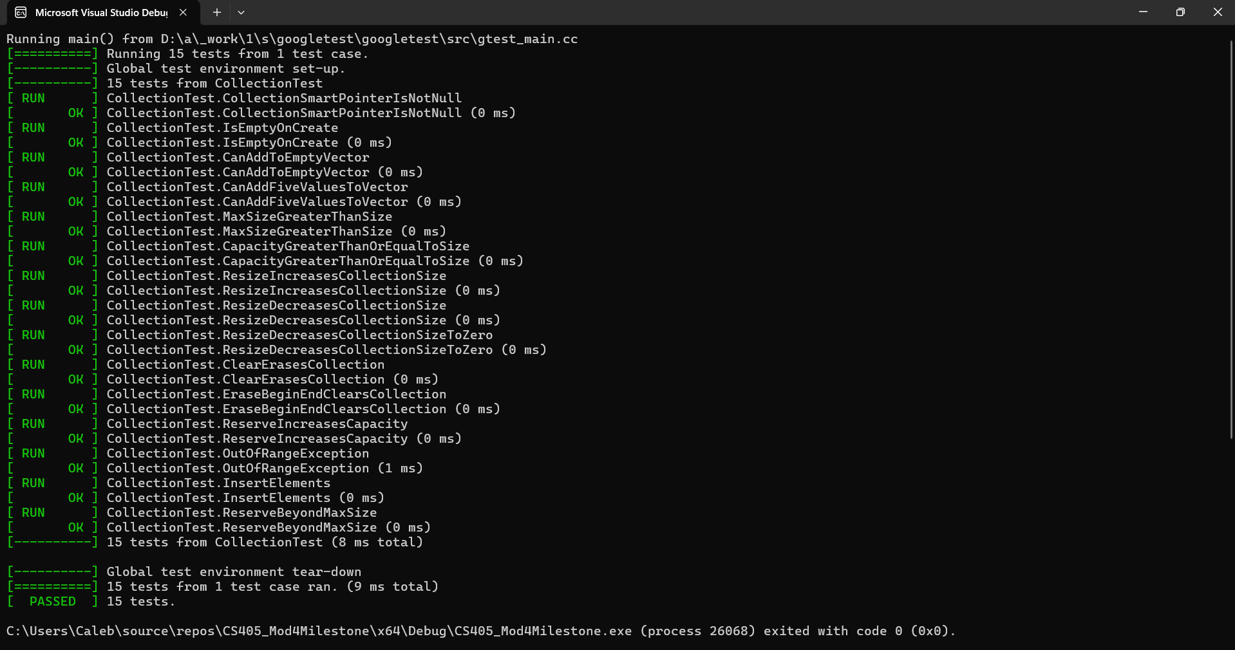
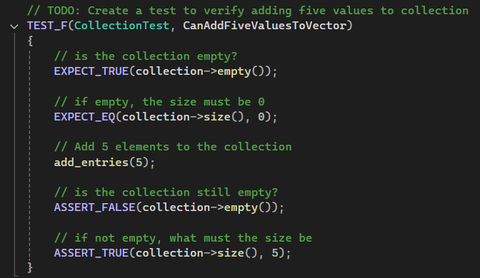
Unit Testing (CanAddFiveValuesToVector)
Notes:
Slide 8-12: Unit Testing "To validate our security measures, we conduct rigorous unit testing. These tests check for vulnerabilities like improper memory handling, invalid inputs, and unauthorized access. By incorporating automated unit tests, we can identify weaknesses early and ensure compliance with security standards."

Slide 9
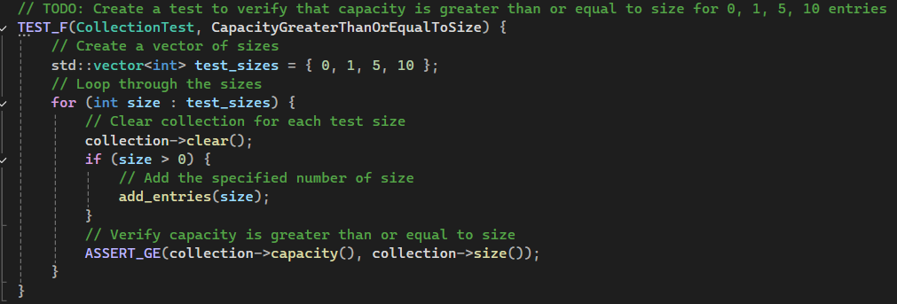
Unit Testing (CapacityGreaterThanOrEqualToSize)

Slide 10
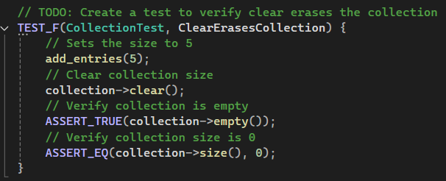
Unit Testing (ClearErasesCollection)

Slide 11
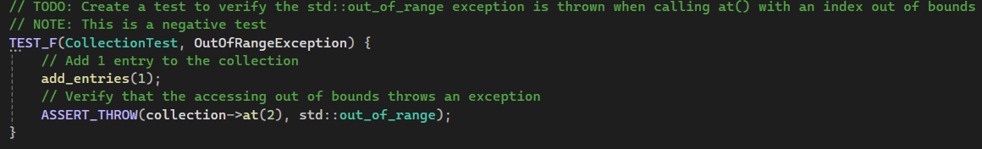
Unit Testing (OutOfRangeException)

Slide 12
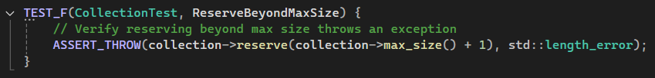
Unit Testing (ReserveBeyondMaxSize)

Slide 13

AUTOMATION SUMMARY
Automation is integrated into the DevSecOps pipeline to streamline security throughout the software development lifecycle. Tools like SonarQube perform static analysis early in development, while OWASP ZAP handles dynamic testing during runtime. This ensures continuous security checks without slowing down development, improving efficiency and reducing vulnerabilities.
Notes:
Slide 13: Automation Summary "Security automation is embedded in our DevSecOps pipeline. Tools like SonarQube perform static analysis during development, while OWASP ZAP conducts dynamic security testing. Automated testing helps detect vulnerabilities early, ensuring continuous security monitoring without slowing down development."

Slide 14
TOOLS
The DevSecOps pipeline ensures security is integrated at every stage of development.
Pre-production: Focuses on secure design and early testing phases.
Design Stage: Security policy implementation and threat modeling using OWASP guidelines.
Build Stage: Utilize IDE security plugins, compilers with security checks, and automated dependency analysis.
Production: Covers deployment, monitoring, and ongoing security enforcement.
Verify and Test Stage: Static analysis tools (e.g., SonarQube), dynamic analysis (e.g., OWASP ZAP), and unit testing frameworks.
Monitor and Detect Stage: Logging mechanisms, SIEM tools, and anomaly detection to track potential threats.
Automating security checks across these stages ensures early vulnerability detection and streamlined compliance.
Notes:
Slide 14: Tools "The DevSecOps pipeline integrates security at every stage. Pre-production phases focus on secure design and threat modeling, while production ensures ongoing monitoring and enforcement. Tools like OWASP ZAP, SonarQube, and SIEM solutions help maintain security throughout the software lifecycle."

Slide 15
RISKS AND BENEFITS
Should security be implemented now or later? → Now!
Benefits of Immediate Implementation:
Reduces vulnerabilities early, minimizing risks of exploitation.
Ensures regulatory and compliance adherence.
Produces robust, secure, and maintainable code from the start.
Risks of Delayed Implementation:
Higher cost and complexity when adding security later.
Greater chance of breaches and compromised sensitive data.
Potential for non-compliance with industry security standards.
Security should be a fundamental aspect of development, not an afterthought.
Notes:
Slide 15: Risks and Benefits "Implementing security measures now reduces long-term risks and costs, preventing data breaches and ensuring compliance. Delaying security can lead to higher remediation expenses and exposure to critical vulnerabilities. By integrating security from the start, we improve system resilience and maintain a strong security posture."

Slide 16
RECOMMENDATIONS
Security policies must be well-documented, understood, and enforced.
DevSecOps training: Regular security awareness sessions for developers to reinforce best practices.
Automated security monitoring:
Implement continuous scanning for software dependencies to prevent supply chain attacks.
Use vulnerability scanning tools to detect and remediate security flaws before deployment.
Access control enhancements: Adopt least privilege access models to minimize potential attack surfaces.
Regular policy reviews: Ensure security policies remain up-to-date with emerging threats and compliance requirements.
Notes:
Slide 16: Recommendations "To strengthen security, we recommend regular DevSecOps training, automated security monitoring for vulnerabilities, and enhanced access control policies. Regular policy reviews ensure compliance with evolving threats, maintaining Green Pace’s commitment to cybersecurity excellence."

Slide 17
CONCLUSIONS
Security must be embedded in every stage of the development lifecycle to prevent vulnerabilities.
Continuous education and training: Developers must be equipped with the knowledge to apply secure coding practices.
Strict enforcement mechanisms: Security requirements should be non-negotiable in the deployment process.
Proactive monitoring and audits: Implement real-time security monitoring and periodic audits to identify and mitigate risks.
Regular updates to security policies: Keep policies aligned with evolving threats and industry standards.
A well-structured security strategy ensures long-term application integrity, data protection, and compliance with regulatory frameworks.
Notes:
Slide 17: Conclusion "Security must be embedded in every stage of the development lifecycle. Continuous training, strict enforcement mechanisms, and proactive monitoring are essential to maintaining a secure development environment. Regular updates to security policies ensure that we stay ahead of emerging threats and industry standards."

Slide 18
REFERENCES
OWASP. (2023). OWASP top ten web application security risks. Open Web Application Security Project. https://owasp.org/www-project-top-ten/
Red Hat. (2023). DevSecOps: Building security into DevOps. https://www.redhat.com/en/topics/devops/what-is-devsecops
Microsoft. (2022). Best practices for a secure software supply chain. Microsoft Learn. https://learn.microsoft.com/en-us/nuget/concepts/security-best-practices
Notes:
Slide 18: References "Here are the references used in this presentation, formatted in APA style. These sources include industry best practices from OWASP, Microsoft, and SEI CERT coding standards, ensuring our security policy aligns with the latest research and recommendations."

